Slide 1

Greedy Algorithm

Slide 2
Greedy Algorithm
An algorithm paradigm that Makes a locally optimal choice in hope of getting a globally optimal solution.
Pros: Simple, faster, Easy to implement
Cons: Very often they don’t provide a globally optimal solution
Problems on which greedy approach works has two properties/characteristics:
Greedy choice property : A globally optimum solution can be arrived at by selecting local optimum solution( Depends on choice made so far but not on future choices)
Optimal Substructure: An optimal solution to the problem contains optimal solution to subproblems
How to design a greedy algorithm?
Find a correct greedy choice: Feasible, locally optimal, irrevocable

Slide 3

Greedy Algorithm
Applications:
Fractional Knapsack problem
Activity selection
Minimum Spanning Tree (Prim and krushkal)
Job sequencing
Huffman coding
Shortest path

Slide 4

Knapsack Problem
n objects and a Knapsack
Object i has weight wi and value vi
Total weight capacity of knapsack: W
Break object so only the fraction is placed
(0<=xi<=1)
Object i contributes →wi*xi weight
→xi*vi profit
Objective: Fill the knapsack that maximizes the profit
n
Maximize ∑ xipi
i=1

Slide 5

Activity selection Problem
Input: A set of activities S = {a₁,…, a_{n}}
Each activity has start time and a finish time a_{i}=(s_{i}, f_{i})
Two activities are compatible if and only if their interval does not overlap
Output: a maximum-size subset of mutually compatible activities

Slide 6
Problem: Laying Telephone Wire
Minimum spanning Tree
Central office

Slide 7
Wiring: Naïve Approach
Central office
Expensive!

Slide 8
Wiring: Better Approach
Central office
Minimize the total length of wire connecting the customers

Slide 9
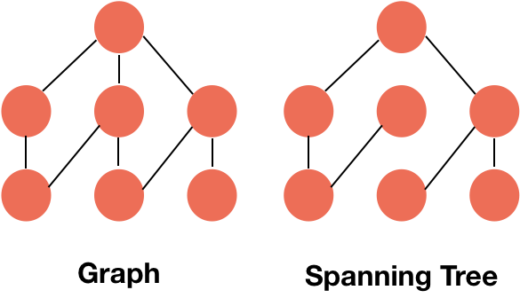
Minimum spanning Tree
A minimum spanning tree is a subgraph of an undirected weighted graph G, such that
it is a tree (i.e., it is acyclic)
it covers all the vertices V
(contains |V| - 1 edges)
the total cost associated with tree edges is
minimum among all possible spanning trees
not necessarily unique

Slide 10
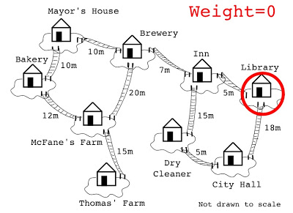
Krushkal’s Algorithm
Remove all the loops and parallel edges
Sort the edges in increasing order of their weight
Temp = null
Add edges to temp: 1) If edge joins nodes of different connected components-> add to temp
2) If edge joins nodes of same connected components-> reject
Stop when temp has n-1 edges
Only one connected component remains which is minimum spanning tree
Graph: Connected
weighted
undirected
No cycles

Slide 11

Prim’s Algorithm
Prim's algorithm treats the nodes as a single tree and keeps on adding new nodes to the spanning tree from the given graph.
Remove all loops and parallel edges
Choose any arbitrary node as root node
Check outgoing edges and select the one with less cost

Slide 12
Application of MST
Cable network companies(Electricity and telephone)
Tv Network
Tour Operators
Cartography and GPS
Medical Image Processing

